Slide 1
Numpy (Numerical Python)
Khashayar mohammadi, Amirhossein ghozati, Ali soleymani

Slide 2
Introduction
Numpy
Numeric Python
Fast computation with n-dimensional arrays

Slide 3
Numpy
Based around one data structure
ndarray
n-dimensional array
Import with import numpy as np
Usage is np.command(xxx)

Slide 4
ndarrays
1d: 5,67,43,76,2,21
a=np.array([5,67,43,76,2,21])
2d: 4,5,8,4
6,3,2,1
8,6,4,3
a=np.array([4,5,8,4],[6,3,2,1],[8,6,4,3])

Slide 5
*, +
import numpy as np
data = randn(2, 3)
print data
print data * 10
print data + data
[[ 0.079 -0.8418 -0.0838]
[-1.4497 0.6628 1.1006]]
[[ 0.7896 -8.4175 -0.8378]
[-14.4973 6.6275 11.0059]]
[[ 0.1579 -1.6835 -0.1676]
[-2.8995 1.3255 2.2012]]

Slide 6
Shape and dtype
print data.shape
print data.dtype
Numpy tries to infer the datatype
OUTPUT
(2L, 3L)
float64

Slide 7
Creating ndarrays
data1 = [6, 7.5, 8, 0, 1]
arr1 = np.array(data1)
print arr1
Output
[ 6. 7.5 8. 0. 1. ]

Slide 8
Multidimensional arrays
data2 = [[1, 2, 3, 4], [5, 6, 7, 8]]
arr2 = np.array(data2)
print arr2
print arr2.ndim
print arr2.shape
OUTPUT
[[1 2 3 4]
[5 6 7 8]]
2
(2L, 4L)

Slide 9
print arr2
print arr2.ndim
print type(arr2.ndim)
print arr2.shape
print type(arr2.shape)
print arr2.shape[0]
print arr2.shape[1]

Slide 10
OUTPUT
[[1 2 3 4]
[5 6 7 8]]
2
<type 'int'>
(2L, 4L)
<type 'tuple'>
2
4
print arr2
print arr2.ndim
print type(arr2.ndim)
print arr2.shape
print type(arr2.shape)
print arr2.shape[0]
print arr2.shape[1]

Slide 11
3d array
data2 = [[[1]]]
arr2 = np.array(data2)
print arr2
print arr2.ndim
print arr2.shape

Slide 12
3d array
data2 = [[[1]]]
arr2 = np.array(data2)
print arr2
print arr2.ndim
print arr2.shape
OUTPUT
[[[1]]]
3
(1L, 1L, 1L)

Slide 13
More making arrays
np.zeros(10)
np.zeros((3, 6))
np.empty((2, 3, 2))
[ 0. 0. 0. 0. 0. 0. 0. 0. 0. 0.]
[[ 0. 0. 0. 0. 0. 0.]
[ 0. 0. 0. 0. 0. 0.]
[ 0. 0. 0. 0. 0. 0.]]
[[[ 0. 0.]
[ 0. 0.]
[ 0. 0.]]
[[ 0. 0.]
[ 0. 0.]
[ 0. 0.]]]

Slide 14
Operations between arrays and scalars
arr = np.array ([1., 2., 3.])
print arr
print arr * arr
print arr - arr
print 1 / arr
print arr ** 0.5

Slide 15
Operations between arrays and scalars
output
[ 1. 2. 3.]
[ 1. 4. 9.]
[ 0. 0. 0.]
[ 1. 0.5 0.3333]
[ 1. 1.4142 1.7321]
arr = np.array ([1., 2., 3.])
print arr
print arr * arr
print arr - arr
print 1 / arr
print arr ** 0.5

Slide 16
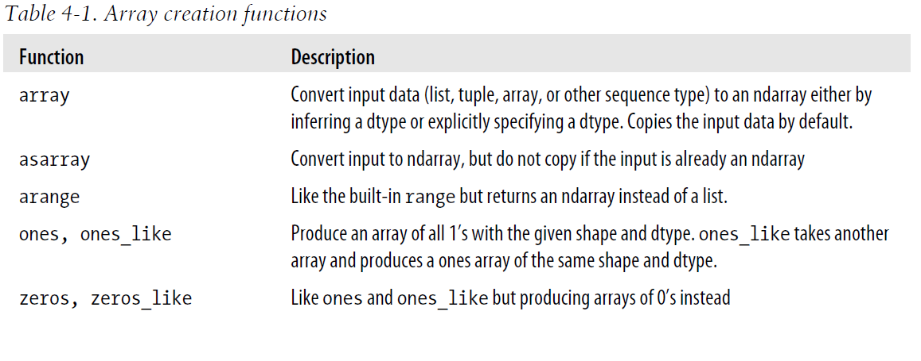
Array creation functions

Slide 17
a=np.array([True], dtype=np.int64)
print a
print a.dtype
a=np.array([True], dtype=np.bool)
print a
print a.dtype

Slide 18
a=np.array([True], dtype=np.int64)
print a
print a.dtype
a=np.array([True], dtype=np.bool)
print a
print a.dtype
[1]
Int64
[ True]
bool

Slide 19
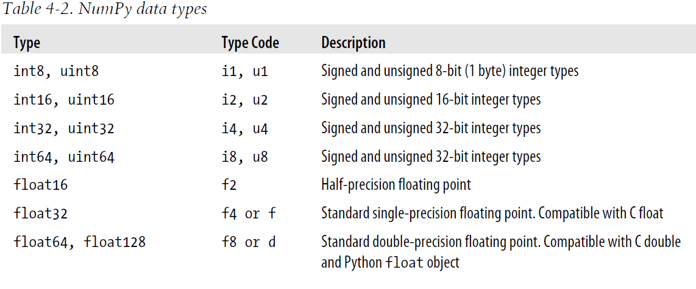
NumPy data types 1

Slide 20
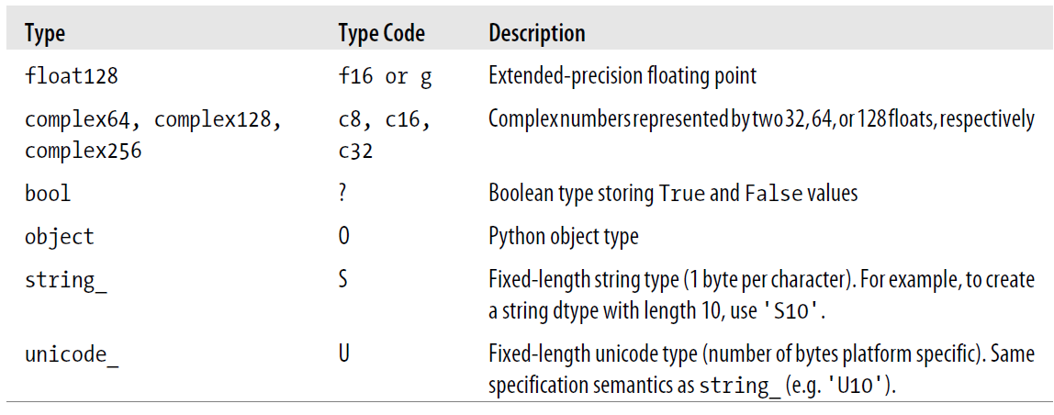
NumPy data types 2

Slide 21
astype
[ 3.7 -1.2 -2.6]
[ 3 -1 -2]
arr = np.array(
[3.7, -1.2, -2.6])
print arr
print arr.astype(np.int32)
note that the data has been truncated.

Slide 22
astype - string to float
numeric_strings = np.array(['1.25', '-9.6', '42'], dtype=np.string_)
print numeric_strings
print numeric_strings.astype(float)
['1.25' '-9.6' '42']
[ 1.25 -9.6 42. ]

Slide 23
Basic indexing and slicing (broadcasting)
arr = np.arange(10)
print arr
print arr[5]
print arr[5:8]
arr[5:8] = 12
print arr
[0 1 2 3 4 5 6 7 8 9]
5
[5 6 7]
[ 0 1 2 3 4 12 12 12 8 9]

Slide 24
The original array has changed
arr_slice = arr[5:8]
arr_slice[1] = 12345
print arr
arr_slice[:] = 64
print arr
[ 0 1 2 3 4 12 12345 12 8 9]
[ 0 1 2 3 4 64 64 64 8 9]

Slide 25
2d array
arr2d = np.array
([[1, 2, 3],
[4, 5, 6],
[7, 8, 9]])
print arr2d[2]
print arr2d[0][2]
print arr2d[0, 2]
(last two are same)
[7 8 9]
3
3

Slide 26
3d array
[[[ 1 2 3]
[ 4 5 6]]
[[ 7 8 9]
[10 11 12]]]
[[1 2 3]
[4 5 6]]
[[ 7 8 9]
[10 11 12]]
arr3d = np.array
([[[1, 2, 3],
[4, 5, 6]],
[[7, 8, 9],
[10, 11, 12]]])
print arr3d
print arr3d[0]
print arr3d[1]

Slide 27
Indexing with slices – 1D
arr = np.arange(10)
print arr
print arr[1:6]
Output
[0 1 2 3 4 5 6 7 8 9]
[1 2 3 4 5]

Slide 28
Indexing with slices – 2D
[[1 2 3]
[4 5 6]
[7 8 9]]
[[1 2 3]
[4 5 6]]
[[2 3]
[5 6]]
arr2d = np.array(
[[1, 2, 3],
[4, 5, 6],
[7, 8, 9]])
print arr2d
print arr2d[:2]
print arr2d[:2, 1:]

Slide 29
Indexing with slices – 2D
arr2d = np.array(
[[1, 2, 3],
[4, 5, 6],
[7, 8, 9]])
print arr2d[1, :2]
print arr2d[2, :1]
print arr2d[:, :1]
[4 5]
[7]
[[1]
[4]
[7]]

Slide 30
Fancy indexing
[[ 0. 0. 0. 0.]
[ 1. 1. 1. 1.]
[ 2. 2. 2. 2.]
[ 3. 3. 3. 3.]
[ 4. 4. 4. 4.]
[ 5. 5. 5. 5.]
[ 6. 6. 6. 6.]
[ 7. 7. 7. 7.]]
[[ 4. 4. 4. 4.]
[ 3. 3. 3. 3.]
[ 0. 0. 0. 0.]
[ 6. 6. 6. 6.]]
[[ 5. 5. 5. 5.]
[ 3. 3. 3. 3.]
[ 1. 1. 1. 1.]]
indexing using integer arrays
arr = np.empty((8, 4))
for i in range(8):
arr[i] = i
print arr
print arr[[4, 3, 0, 6]]
print arr[[-3, -5, -7]]
Negative index select from the end

Slide 31
Transposing arrays and swapping axes
[[ 0 1 2 3 4]
[ 5 6 7 8 9]
[10 11 12 13 14]]
(3L, 5L)
[[ 0 5 10]
[ 1 6 11]
[ 2 7 12]
[ 3 8 13]
[ 4 9 14]]
(5L, 3L)
arr = np.arange(15).reshape((3, 5))
print arr
print arr.shape
print arr.T
print arr.T.shape

Slide 32
Inner Product (dot operator)
[[0 1]
[2 3]]
[[0 2]
[1 3]]
[[ 4 6]
[ 6 10]]
[[ 1 3]
[ 3 13]]
arr = np.arange(4).
reshape((2, 2))
print arr
print arr.T
print np.dot(arr.T, arr)
print np.dot(arr, arr.T)

Slide 33
Inner Product (dot operator)
arr = np.arange(9).reshape((3, 3))
print arr
print np.dot(arr.T, arr)
[[0 1 2]
[3 4 5]
[6 7 8]]
[[45 54 63]
[54 66 78]
[63 78 93]]

Slide 34
arr*arr
arr = np.arange(9).reshape((3, 3))
print arr
print arr*arr
[[0 1 2]
[3 4 5]
[6 7 8]]
[[ 0 1 4]
[ 9 16 25]
[36 49 64]]

Slide 35
Fast element-wise array functions
arr = np.arange(5)
print arr
print np.sqrt(arr)
print np.exp(arr)
[0 1 2 3 4]
[ 0. 1. 1.4142 1.7321 2. ]
[ 1. 2.7183 7.3891 20.0855 54.5982]

Slide 36
element-wise maximum
x = randn(4)
y = randn(4)
print x
print y
print np.maximum(x, y)
[-0.9691 -1.4411 1.2614 -0.9615]
[-0.0398 -0.0692 -1.6854 -0.3902]
[-0.0398 -0.0692 1.2614 -0.3902]

Slide 37
element-wise add
x = randn(4)
y = randn(4)
print x
print y
print np.add(x, y)
[ 0.0987 -1.2579 -1.4827 -1.4299]
[-0.2855 -0.7548 -1.0134 0.7546]
[-0.1868 -2.0127 -2.4961 -0.6753]

Slide 38

Zip two lists together
a = [1,2,3]
b = [10, 20, 30]
zipAB = zip(a,b)
print zipAB
OUTPUT
[(1, 10), (2, 20), (3, 30)]

Slide 39
Zip three lists together
a = [1,2,3]
b = [10, 20, 30]
c = [True, False, True]
zipABC = zip(a,b,c)
print zipABC
Output
[(1, 10, True), (2, 20, False), (3, 30, True)]

Slide 40
And is the same as
a = [1,2,3]
b = [10, 20, 30]
c = [True, False, True]
result = [(x,y,z)
for x, y, z in zip(a,b,c)]
print result
Output
[(1, 10, True), (2, 20, False), (3, 30, True)]

Slide 41
conditionals
result = [(x if z else y)
for x, y, z in zip(a,b,c)]
print result
OUTPUT
[1, 20, 3]
NOTE depending on the boolean value, it decides which list to take value from.

Slide 42
where
an easier way to do this with np
a = [1,2,3]
b = [10, 20, 30]
c = [True, False, True]
np.where(c,a,b)
Output is [ 1 20 3]

Slide 43
types
result = [(x if z else y)
for x, y, z in zip(a,b,c)]
print type(result)
result = np.where(c,a,b)
print type(result)
<type 'list'>
<type 'numpy.ndarray'>

Slide 44
where(arr > 0, 2, -2)
arr = randn(4, 4)
arr
print np.where(arr > 0, 2, -2)
[[ 2 2 -2 -2]
[-2 2 -2 2]
[-2 -2 -2 -2]
[ 2 -2 2 2]]

Slide 45
where(arr > 0, 2, arr)
arr = randn(4, 4)
Arr
print np.where(arr > 0, 2, arr)
[[ 2. 2. -0.9611 -0.3916]
[-1.0966 2. -1.9922 2. ]
[-0.2241 -0.9337 -0.8178 -1.1036]
[ 2. -1.096 2. 2. ]]

Slide 46
Mathematical and statistical methods
arr = np.random.randn(5, 4)
print arr.mean()
print np.mean(arr)
print arr.sum()

Slide 47
Axis
An array has an axis.
These are labelled 0, 1, 2, …
These are just the dimensions.

Slide 48
Mean of rows/columns (axis)
arr = np.array([[0, 1, 2], [3, 4, 5], [6, 7, 8]])
print arr
print arr.mean(axis=0)
print arr.mean(axis=1)
[[0 1 2]
[3 4 5]
[6 7 8]]
[ 3. 4. 5.]
[ 1. 4. 7.]

Slide 49
Sum different axis
arr = np.array([[0, 1, 2], [3, 4, 5], [6, 7, 8]])
print arr
print arr.sum(0)
print arr.sum(1)
[[0 1 2]
[3 4 5]
[6 7 8]]
[ 9 12 15]
[ 3 12 21]

Slide 50
Cumulative sum
[[0 1 2]
[3 4 5]
[6 7 8]]
[[ 0 1 2]
[ 3 5 7]
[ 9 12 15]]
[[ 0 1 3]
[ 3 7 12]
[ 6 13 21]]
arr = np.array(
[[0, 1, 2],
[3, 4, 5], [6, 7, 8]])
print arr
print arr.cumsum(0)
print arr.cumsum(1)
This is across different axis.

Slide 51
Cumulative product
[[0 1 2]
[3 4 5]
[6 7 8]]
[[ 0 1 2]
[ 0 4 10]
[ 0 28 80]]
[[ 0 0 0]
[ 3 12 60]
[ 6 42 336]]
arr = np.array(
[[0, 1, 2],
[3, 4, 5], [6, 7, 8]])
print arr
print arr.cumsum(0)
print arr.cumsum(1)
This is across different axis.

Slide 52
Methods for Boolean arrays
output
2
(of course
This
Number
Can
change)
arr = randn(10)
print (arr > 0).sum()
1/ makes a random array
2/ counts only the positive entries.

Slide 53
Methods for Boolean arrays
bools = np.array(
[False, False, True, False])
print bools.any()
print bools.all()
This asks if all/any in bools is true.
output
True
False

Slide 54
Sorting 1
arr = randn(4)
print arr
arr.sort()
print arr
OUTPUT
[-0.301 -0.1785 -0.9659 -0.6087]
[-0.9659 -0.6087 -0.301 -0.1785]

Slide 55
SORTING 2
[[1 3 2]
[8 4 9]
[3 5 8]]
[[1 3 2]
[3 4 8]
[8 5 9]]
[[1 2 3]
[3 4 8]
[5 8 9]]
arr = randn(2, 3)
print arr
arr.sort(0)
print arr
arr.sort(1)
print arr
sorting on different axis

Slide 56
Unique and other set logic
names = np.array(['Bob', 'Joe', 'Will', 'Bob', 'Will', 'Joe', 'Joe'])
print np.unique(names)
print sorted(set(names))
OUTPUT
['Bob' 'Joe' 'Will']
['Bob', 'Joe', 'Will']

Slide 57
Testing Membership
Test if something is in an array.
values = np.array([6, 0, 0, 3, 2, 5, 6])
print np.in1d(values, [2, 3, 6])
Output
[ True False False True True False True]

Slide 58
Storing arrays on disk in binary format
arr = np.arange(10)
print arr
np.save('some_array', arr)
arr1 = np.load('some_array.npy')
print arr1
NOTE THE file extension is npy

Slide 59
Saving multiple arrays
arr3 = np.arange(3)
arr5 = np.arange(5)
np.savez('array_archive.npz', a=arr3, b=arr5)
arch = np.load('array_archive.npz')
print type(arch)
print arch['a']
print arch['b']
print dict(arch)

Slide 60
np.load returns dict-like object
<class 'numpy.lib.npyio.NpzFile'>
[0 1 2]
[0 1 2 3 4]
{'a': array([0, 1, 2]), 'b': array([0, 1, 2, 3, 4])}

Slide 61
Saving and loading text files
arr = np.loadtxt('array_ex.txt', delimiter=',')
print arr
print type(arr)
OUTPUT
[[ 1. 2. 3. 4.]
[ 3. 4. 5. 6.]]
<type 'numpy.ndarray'>
array_ex.txt
1,2,3,4
3,4,5,6

Slide 62
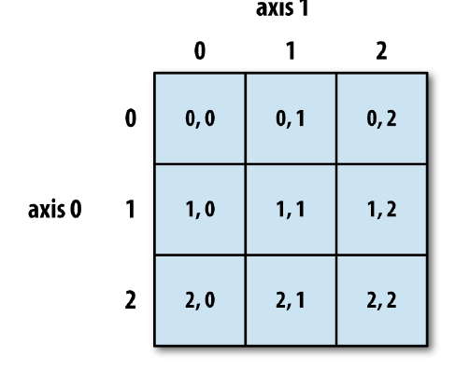
Indexing elements in a NumPy array

Slide 63
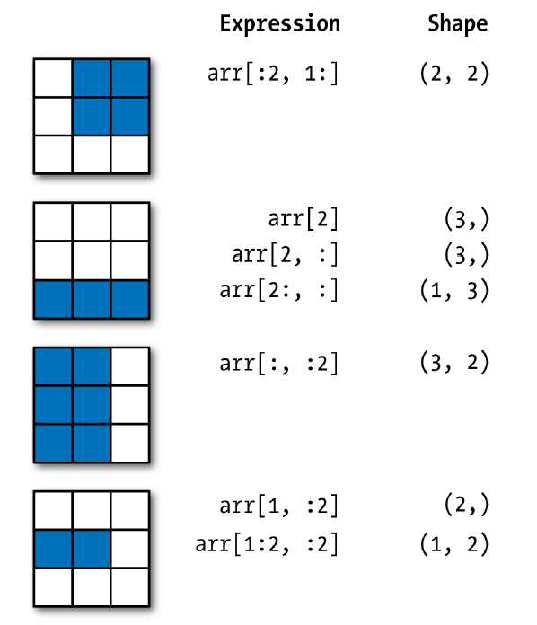
Two- dimensional array slicing

Slide 64
Slicing
Remember, slicing range:
a:b
Means elements from a up to b-1

Slide 65
Data Types
Every element in an ndarray has the same type
Basic types:
int
float
complex
bool
object
string
unicode

Slide 66
Data Types
Types also have a defined size in bytes, e.g.
int32
float64
The size defines storage size and accuracy
To set the type:
a=np.array([1,2], dtype=np.int32)
print a.dtype
OUTPUT IS dtype('int32')

Slide 67
Iterating and Processing
You can iterate through a ndarray if you like:
for e in a:
print e
or
for e in a[0]:
print e
etc. but this is complicated an not advised
There is a better way ...

Slide 68
Element-wise Operations
a=a*2
a=a+5
a=a+b
etc.
Functions:
a.sum()
a.max()
a.mean()
a.round()

Slide 69
Slices and Indexes
a[0]=a[0]/2
a[0,0,0]+=1
a[:,1,1].sum()

